Slide 1
Leveraging Data Analysis For Optimal Marketing
TEAM ID : NM2023TMID07102
TEAM LEADER : UDAYAKUMAR S
TEAM MEMBERS : SAMUEL SOLOMON,
SRIRAM K
SURYA S
SAKTHIMAN SABARI S

Slide 2
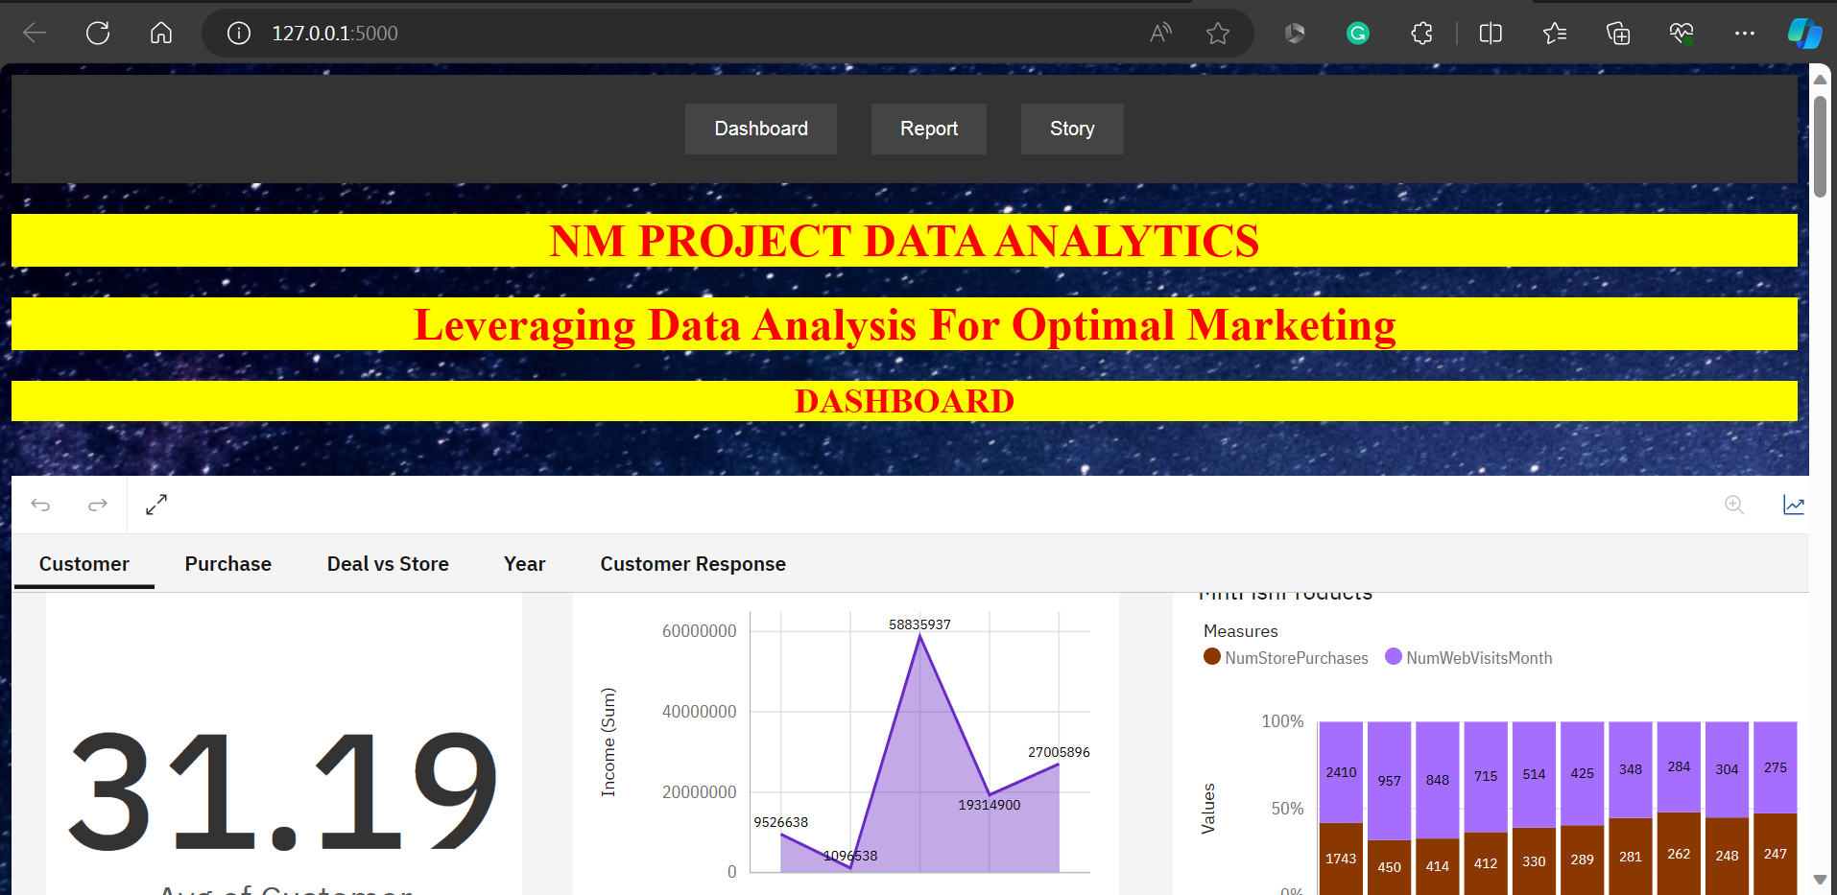

Slide 3
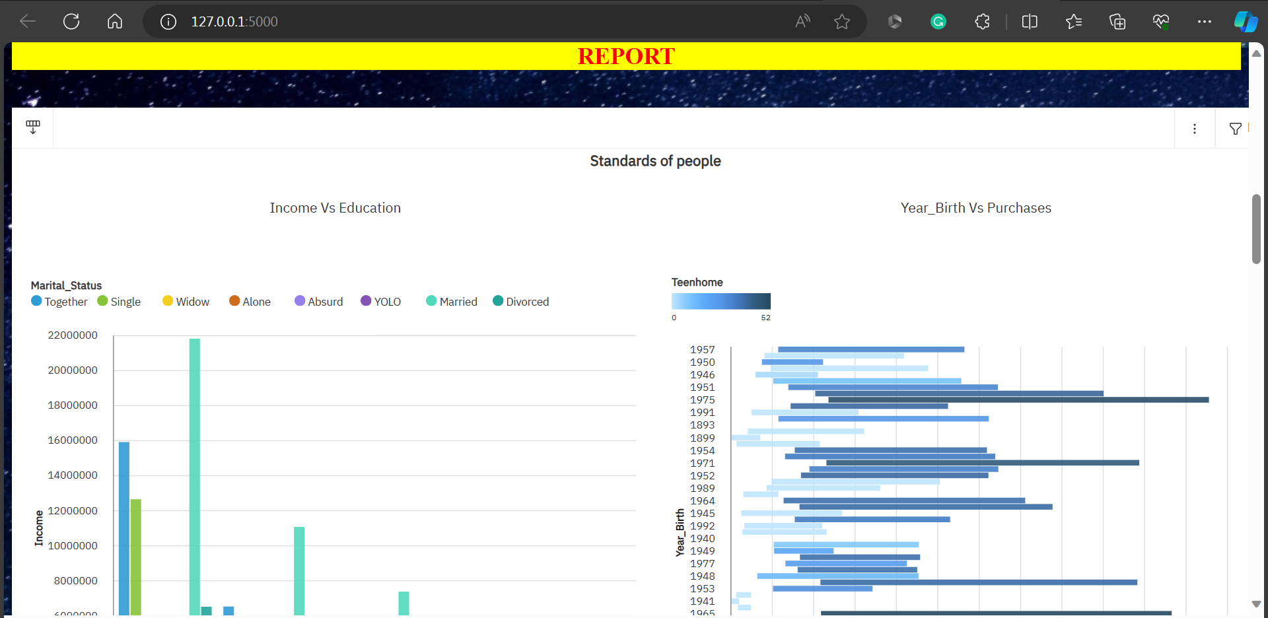

Slide 4
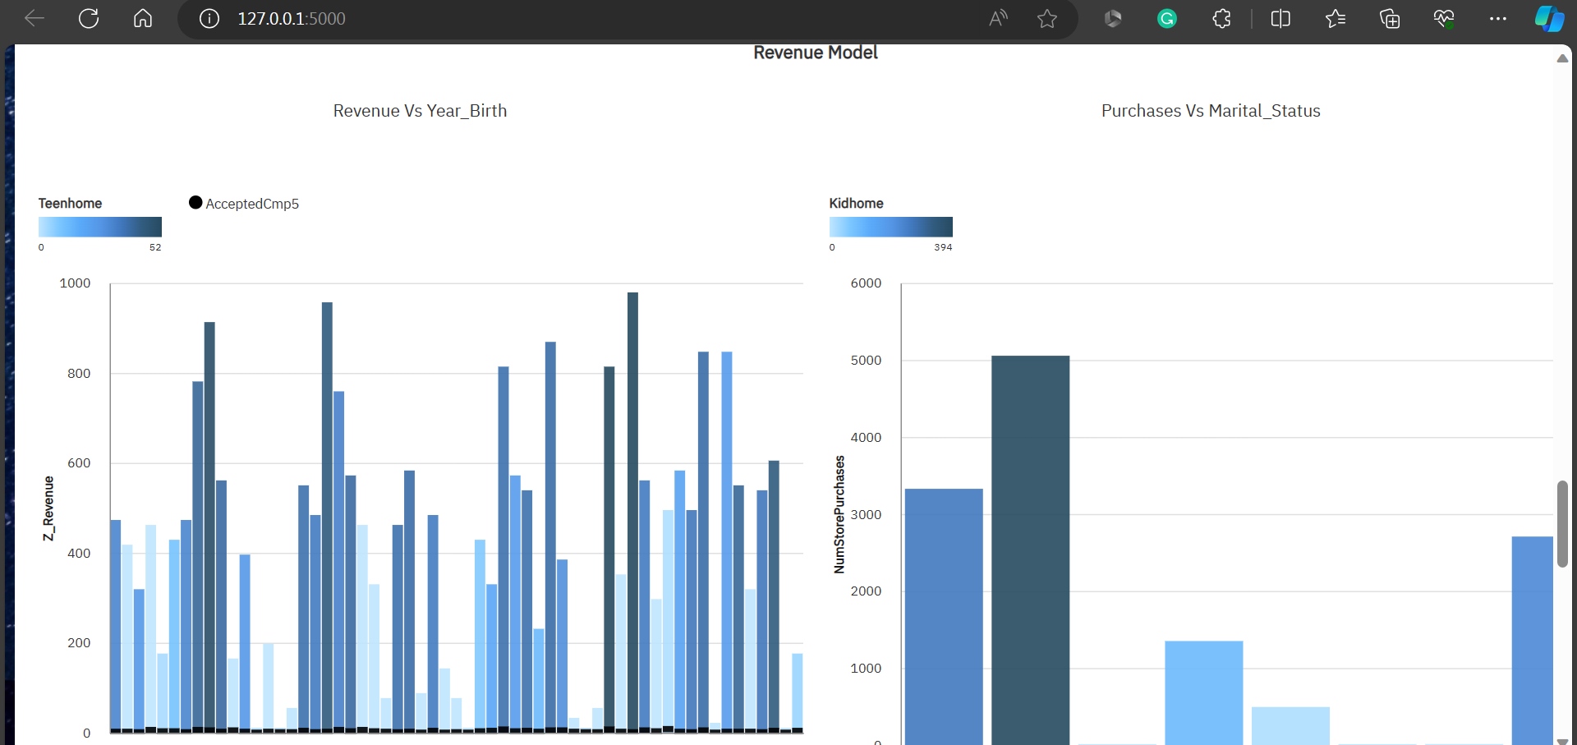

Slide 5
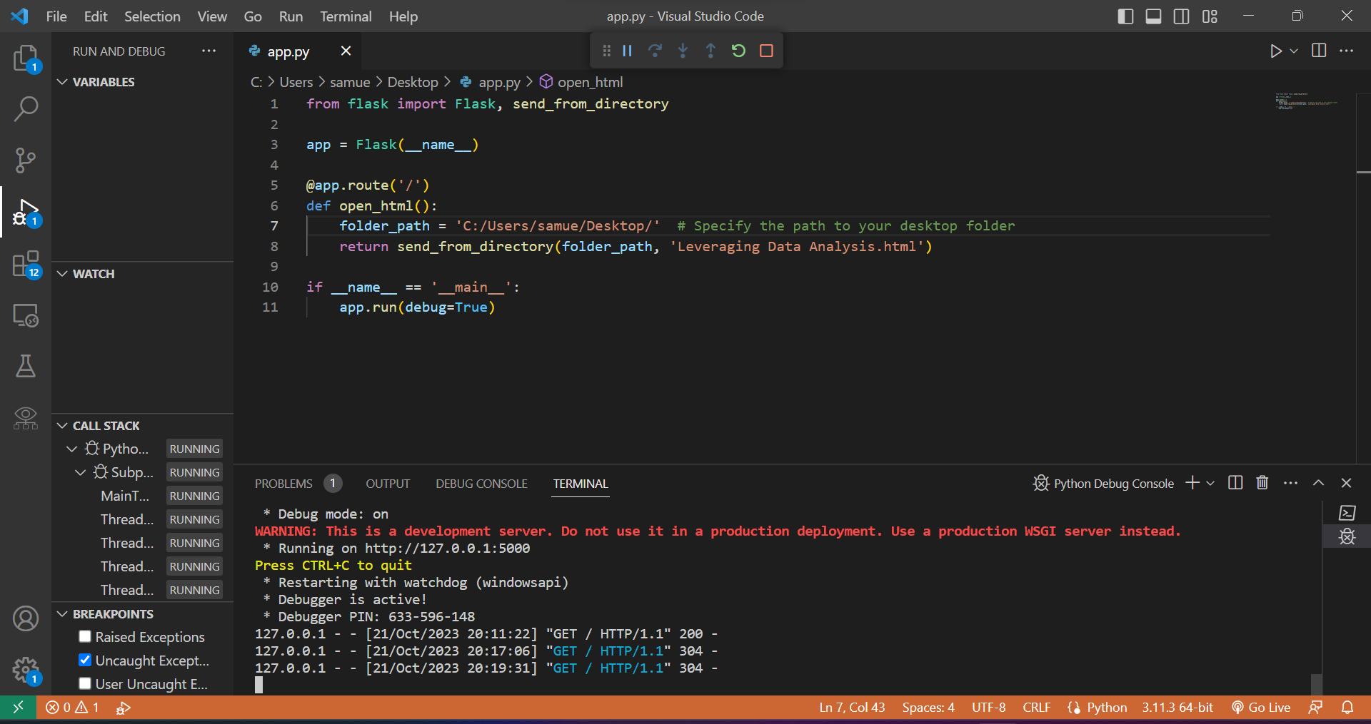

Slide 6
